Slide 1
Safety and Performance Through Self-Awareness
Notes:
Participant notes:
Welcome to Safety and Performance Through Self-Awareness. This information highlight Human Performance Improvement at an individual level.
Facilitator Notes:
Welcome the participants to the course.

Slide 2




Administrative Notes
Safety information
Security
Emergency
Facilities
Water
Restrooms
Notes:
Participant notes:
The instructor will explain safety, emergency, security, and other information during this section of the course. The information is relevant to the time and location of the live course.
Facilitator notes:
Inform the participants and attendees of the site-specific safety, security, and emergency requirements and the actions to take in case of an emergency. Additionally, inform the participants and attendees of the restrooms, water fountains/fill stations, and any other information relevant to the site and their comfort and safety.

Slide 3
Safety and Performance Through Self-Awareness
Goal:
Equip individuals with information and tools to enhance personal performance, reduce errors, and develop self-awareness to contribute effectively to workplace safety and efficiency.
Objectives:
Defining Human Performance Improvement
Identifying and Managing Human Error
Recognizing and Leveraging Tools for Individual Performance
Notes:
Participant notes:
Goal:
Equip individuals with information and tools to enhance personal performance, reduce errors, and develop self-awareness to contribute effectively to workplace safety and efficiency.
Objectives:
Defining Human Performance Improvement
Identifying and Managing Human Error
Recognizing and Leveraging Tools for Individual Performance
Facilitator notes:
Review the goals and the objectives with the participants.

Slide 4

Introduction to Human Performance Improvement
Understanding Human Performance and its role in workplace safety
The impact of individual behaviors on overall organizational success
Safe Conduct of Research (SCoR)
Notes:
And at home?
Participant notes:
Facilitator notes:

Slide 5
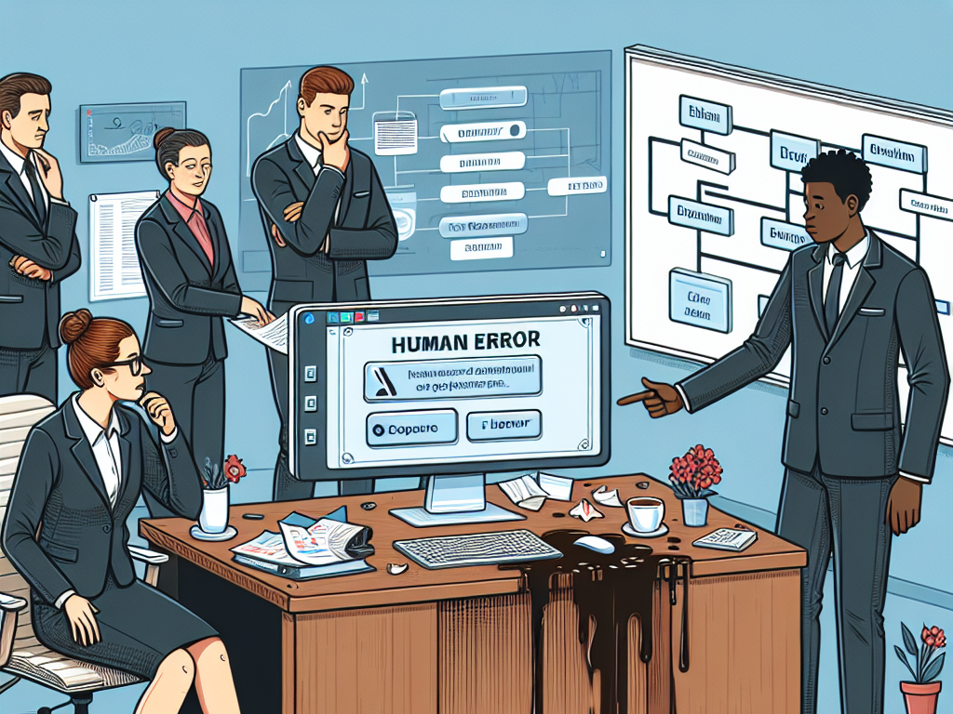
Identifying and Managing Human Error
Human error:
Refers to mistakes made by individuals due to lapses in judgment, knowledge, skill, or attention.
Other errors:
Typically involve issues arising from processes, systems, or external factors such as environmental conditions, equipment failures, or procedural inefficiencies.
Notes:
Participant notes:
Human Error:
Refers to mistakes made by individuals due to lapses in judgment, knowledge, skill, or attention.
Originates from individuals.
Caused by cognitive, perceptive, or motor skill lapses of individuals.
Influenced by factors such as fatigue, stress, lack of training, or distractions.
Examples include forgetting to perform a step in a procedure, misinterpreting information, or executing a task incorrectly.
Other Errors:
Typically involve issues arising from processes, systems, or external factors such as environmental conditions, equipment failures, or procedural inefficiencies.
Originates from external systems, processes, or conditions.
Arise from system-level issues, design flaws, or external influences.
Includes factors such as inadequate infrastructure, poor design, disruptive environmental conditions, or outdated technology.
Examples include software glitches, mechanical failures, poor organizational processes, or unforeseen environmental conditions.
Understanding these differences helps organizations determine appropriate strategies for error prevention and mitigation, ensuring both human factors and systemic issues are addressed.
Facilitator notes:

Slide 6
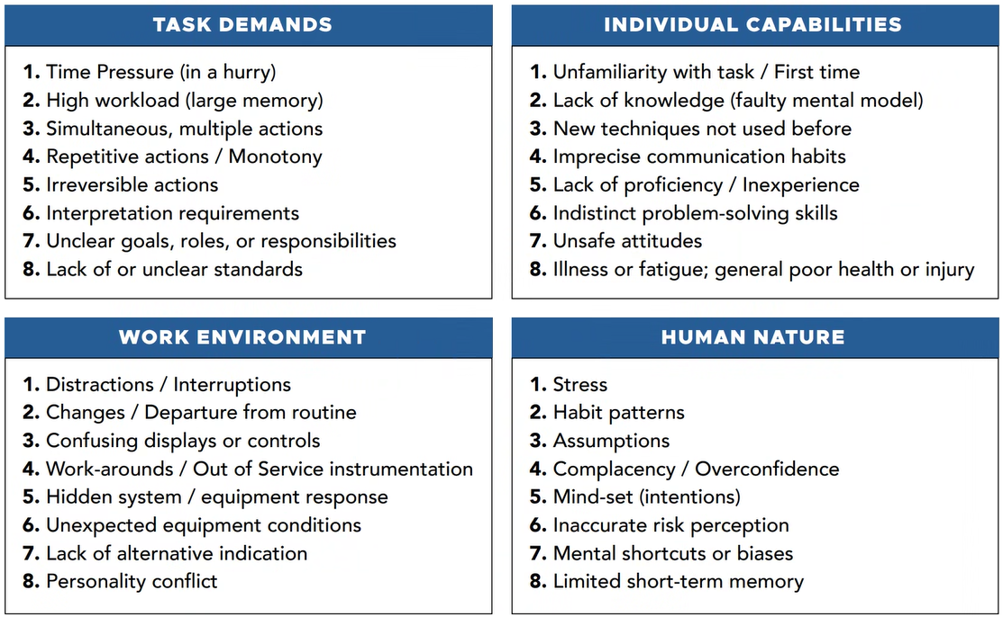
Error Precursors: Conditions that Provoke Human Error
Notes:
Participant notes:
Facilitator notes:
Explain that these precursors are high level and today’s focus is on Individual Capabilities and Human Nature.

Slide 7

Types of Human Error
People do not err intentionally. We are all fallible.
Slips
Occur when the physical action fails to achieve the immediate objective.
Lapses
Involve a failure of one’s memory or recall.
Mistakes
Active Errors - observable, physical actions that change equipment, system, or facility state, resulting in immediate undesired consequences.
Latent Errors - Result in hidden organization-related weaknesses or equipment flaws that lie dormant.
Violations
characterized as the intentional (with forethought) circumvention of known rules or policy.
Notes:
Participant notes:
Facilitator notes:

Slide 8

Recognizing and Mitigating At-Risk Behaviors
A Questioning Attitude
Self-Monitoring and Awareness
Identifying Biases and triggers
Situational and Environmental Awareness
Notes:
Participant notes:
Facilitator notes:
A questioning attitude is where individuals seek clarification before proceeding, especially in the face of uncertainty. It is the willingness to challenge assumptions and prioritizing safety over production.
What must go right?
What can go wrong?

Slide 9
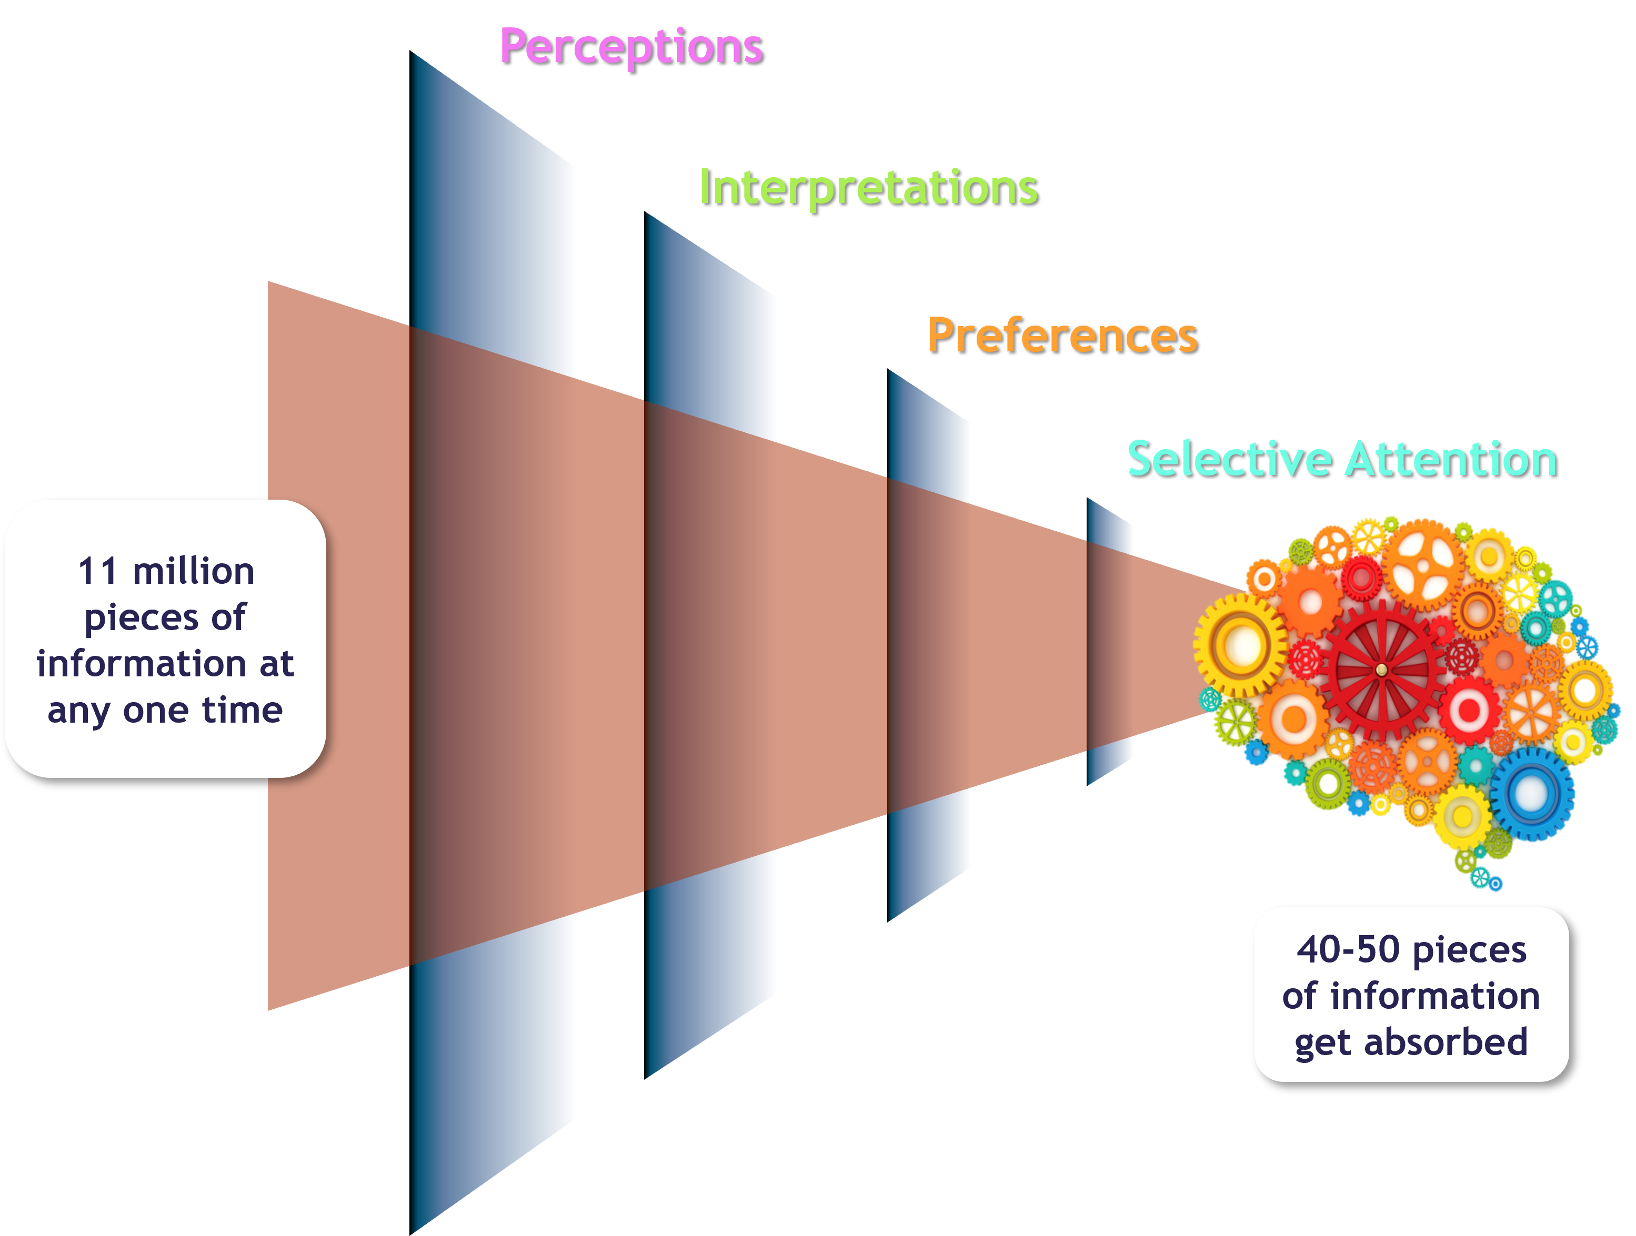
A Questioning Attitude
x
Notes:
Participant notes:
Facilitator notes:
What needs to go right as well as what can go wrong?
Observation overload
Self advocacy
Respect
Communication? Feedback? Trust?

Slide 10
Self-Monitoring and Awareness
y
Notes:
Participant notes:
Facilitator notes:
Mental Fatigue
Yawning
Lack of focus, distracted
Small mistakes (typing, dropping, forgetting)
HALT (Hungry, Angry, Tired, Lonely)
Definition: Self-awareness involves recognizing your emotional states, thoughts, and physical conditions and understanding how these influence your behavior and decisions. It plays a critical role in preventing errors by helping you recognize when you're more likely to make mistakes due to internal factors such as stress, fatigue, or distraction.
Elaboration: When you're aware of your internal state, you're better equipped to manage your reactions and take steps to mitigate potential errors. For example, if you realize you're fatigued or stressed, you may choose to take a break before continuing an important task.
Example: A doctor feeling stressed due to a heavy workload might recognize that their attention is waning. By acknowledging this, they can ask for a colleague’s help or take a brief pause to regain focus, preventing errors in diagnosis or treatment.

Slide 11
Biases and Triggers
Cognitive Bias
Confirmation Bias
Emotional Triggers
Complacency
Normalization of Deviance
Notes:
Participant notes:
Facilitator notes:
Cognitive bias refers to a systematic pattern of deviation from norm or rationality in judgment, whereby individuals create their own "subjective reality" from their perception of the input. These biases often result from the brain's attempt to simplify information processing. Cognitive biases can lead to perceptual distortion, inaccurate judgment, illogical interpretation, and irrational decision-making.
Confirmation bias is the tendency for people to favor information that confirms their pre-existing beliefs or hypotheses while disregarding or dismissing information that contradicts them. This cognitive bias can lead to skewed interpretation of evidence, faulty decision-making, and reinforcement of erroneous beliefs.
Emotional triggers are specific events, situations, or stimuli that provoke an intense emotional reaction. These reactions can be positive or negative and often stem from past experiences, personal sensitivities, or unresolved issues. Emotional triggers can lead to feelings such as anger, sadness, fear, joy, or excitement, impacting how individuals respond to certain situations.
Complacency
Normalization of Deviance
Definition: Cognitive biases are systematic errors in thinking that can influence judgment and decision-making. Emotional triggers are responses to situations that cause strong emotional reactions. Being aware of these biases and triggers allows individuals to make more rational decisions and avoid errors that arise from flawed thinking or overreactions.
Elaboration: Recognizing when cognitive biases (e.g., confirmation bias) or emotional triggers (e.g., anger from criticism) affect your decisions can help you pause and reconsider your response. This self-awareness helps reduce errors in judgment or decision-making.
Example: If you're prone to confirmation bias, you may seek out information that supports your preexisting beliefs. If you recognize this tendency, you can actively search for contradictory information to ensure a balanced decision.

Slide 12
Situational and Environmental Awareness
y
Notes:
Participant notes:
Facilitator notes:
Observations
Yoda
Sheepdog
Definition: Situational awareness involves understanding your environment and recognizing potential risks or changes in your surroundings.
Elaboration: Exercises to improve situational awareness can include scanning the environment, assessing risks, and predicting potential outcomes. This can help individuals make better decisions by anticipating challenges or dangers.
Example: While walking in a crowded space, a situational awareness exercise could involve scanning for potential obstacles or people who might pose a risk (e.g., someone walking erratically or vehicles approaching).

Slide 13

Tools for Individual Performance
Strategies to Help Prevent Errors and Mistakes
Environmental Adjustments
Cognitive and Behavioral Strategies
Physiological Strategies
Lifestyle Strategies
Notes:
Participant notes:
Facilitator notes:

Slide 14
Environmental Adjustment
Workspace Organization
Temperature and Ventilation
Task Specific Zone
Visual Cues and Signage
Electrical
Ergonomic
Lighting
Notes:
Participant notes:
Facilitator notes:
Place keeping (Elmo reminder for USB)
Do not disturb time and sign

Slide 15
Cognitive and Behavioral Strategies
Mental Rehearsal
Attention Management
Chunking Information
Decision Making Framework (SWOT, Decision Trees)
Regular Breaks
Review and Reflection
Self-Awareness (Intentional Awareness, Mindfulness)
Checklists and Standard Procedures
Time Management
Task Prioritization
Continuous Learning
Habits and Routines
Review, Reflection, Journaling
Self-Monitoring
Notes:
Participant notes:
Facilitator notes:
C:
STOP-Stop, Think, Observe, Proceed)
HALT (Hunger, Angry, Tired, Loneley)
B:
Pause, do a mental-physical inventory
Identify thoughts and capture for later
Begin the day - What does a safe, respectful, caring, high producer do? Today I am going to perform like one who _______.
10 second pause
Self-Check,
Am I in the “zone”? Do I need to be? What does this look like?
Guardrails

Slide 16
Physiological and Lifestyle Strategies
Adequate Sleep
Positive Attitude and Mindset
Limit Multitasking
Deep Breathing Exercises
Stretching and Exercise
Nutrition
Hydration
Notes:
Better Up (site and app)
Health provider
Life coach (Jon Acuff, Corrin Crabtree, Elizabeth Benton, Brendon Burchard, Jack Canfield, Brene Brown)
Accountability buddy
Years of college and professional experience…what self mastery?

Slide 17
Scenarios
x
Notes:
Participant notes:
Facilitator notes:
Scenario 1: Handling Task Uncertainty Situation: You are assigned a critical task but notice inconsistencies in the procedure. What actions should you take to ensure accuracy and safety?
Implementation: Use the "Pause When Unsure" tool—stop the task, verify procedures, and consult a supervisor before proceeding.
Discussion: Importance of questioning attitude and validation techniques.
Example: A technician notices a discrepancy in a maintenance checklist. Instead of proceeding, they stop work, review the procedure, and confirm with a supervisor before continuing.
Scenario 2: Overcoming Error-Likely Situations Situation: You are under time pressure and tempted to bypass a verification step. What should you do?
Implementation: Apply "Self-Checking" (STAR—Stop, Think, Act, Review) to ensure proper execution and minimize risks. Discussion: Implementing self-checking, stopping when unsure, and peer reviews.
Example: An engineer about to activate a system pause to self-check, confirming the right switch is being engaged, ensuring safety before proceeding .
Scenario 3: Handling Unclear Communication Situation: Instructions from a supervisor are vague, but the task has high safety implications. How should you proceed?
Implementation: Utilize "Three-Way Communication"—repeat back instructions to confirm understanding and ensure alignment.
Discussion: The role of effective communication and three-way communication techniques.
Example: A control room operator receives instructions to adjust a valve. They repeat the instruction back, clarify any ambiguities, and confirm before making adjustments.
Find one leader to give example?
Mitchell will reach out to team leads (Michael Fox (1 or 2).
Mitchell has an example on this-electrical/verify.

Slide 18
Summary
Observation
Identifying and Managing Human Error
Error Precursors: Conditions that Provoke Human Error
Recognizing and Mitigating At-Risk Behaviors
Preventing Errors & Mistakes
Tools for Individual Performance Behavioral Strategies
SCoR
Notes:
Participant notes:
Facilitator notes:
Hand out SCoR cards and reference materials. (Better Up, Books, DOE Handbook-link, course work on mindfulness – self talk, etc.)
Ask:
What have we missed in this hour? Backpack. Propped open door. Random cables.

Slide 19
Notes:
Participant notes:
Thank you for attending and participating in this engagement on Safety and Performance Through Self-Awareness.
Facilitator notes:
Dismiss the participants and thank them for their attendance and participation.

